Slide 1
An introduction to SOLID Programming
Jacob Archambault

Slide 2
1 Overview

Slide 3
1.1 The problem
Programs can be written in many ways
Some ways of writing programs are better than others
For the end user
Performance
Navigability
For potential collaborators
Readability

Slide 4
1.2 What is SOLID programming?
Invented by Bob Martin in the early 2000s
Co-authored the Agile Manifesto
Author of Clean Code: A Handbook of Agile Software Craftsmanship
Goal – to provide principles for producing software that can easily be read, maintained, and expanded on

Slide 5
1.3 The principles of SOLID programming
S – Single Responsibility Principle
O – Open-Closed Principle
L – Liskov Substitution Principle
I – Interface Segregation Principle
D – Dependency Inversion Principle
Do one thing!
Don’t change existing working functionality, extend it; avoid if-else/case-switch statements
Don’t cast. Better yet, avoid inheritance altogether
Interfaces shouldn’t be 1-1 copies of their implementations
Calling, not called, parts specify what they need to operate

Slide 6
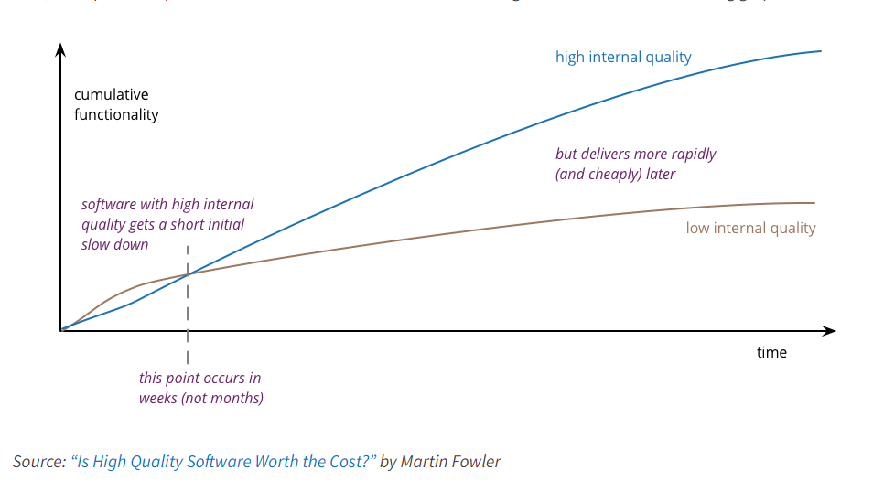
1.4 Is it worth it?

Slide 7
2 The Single Responsibility Principle

Slide 8
2.1 The Single Responsibility Principle
“Each software module should have one and only one reason to change” – Bob Martin
“We have tried to demonstrate by these examples that it is almost always incorrect to begin the decomposition of a system into modules on the basis of a flowchart. We propose instead that one begins with a list of difficult design decisions or design decisions which are likely to change. Each module is then designed to hide such a decision from the others.” – D. L. Parnas, ‘On the Criteria To Be Used in Decomposing Systems into Modules’

Slide 9
2.2 The concept of a module
Module: a self-contained component of a system that can be removed or substituted out for a similar unit without detriment to the functionality of other parts of the whole it belongs to
Example:
The modules of a psychology textbook
External DVD drive
Car brakes
A human kidney
Types of modules in software development:
Methods/functions
Classes
Projects

Slide 10
2.3 Modularity in software development: command-query separation
Command-query separation
Methods should either return a value or execute a command (void), not both.
Some older languages, e.g. Pascal, enforce this distinction as one between functions and procedures
Applications:
Return newly created objects, not changed objects (e.g. avoid Init() methods)
Avoid overwriting existing variables – instead, create new ones
Distinguish read from write interfaces, e.g. IReadRepo, IWriteRepo
If a command must return something, make it a Boolean (not, e.g. a success message – this can be specified by the calling application)
Separate business layers from layers accessing external resources – hexagonal architecture

Slide 11
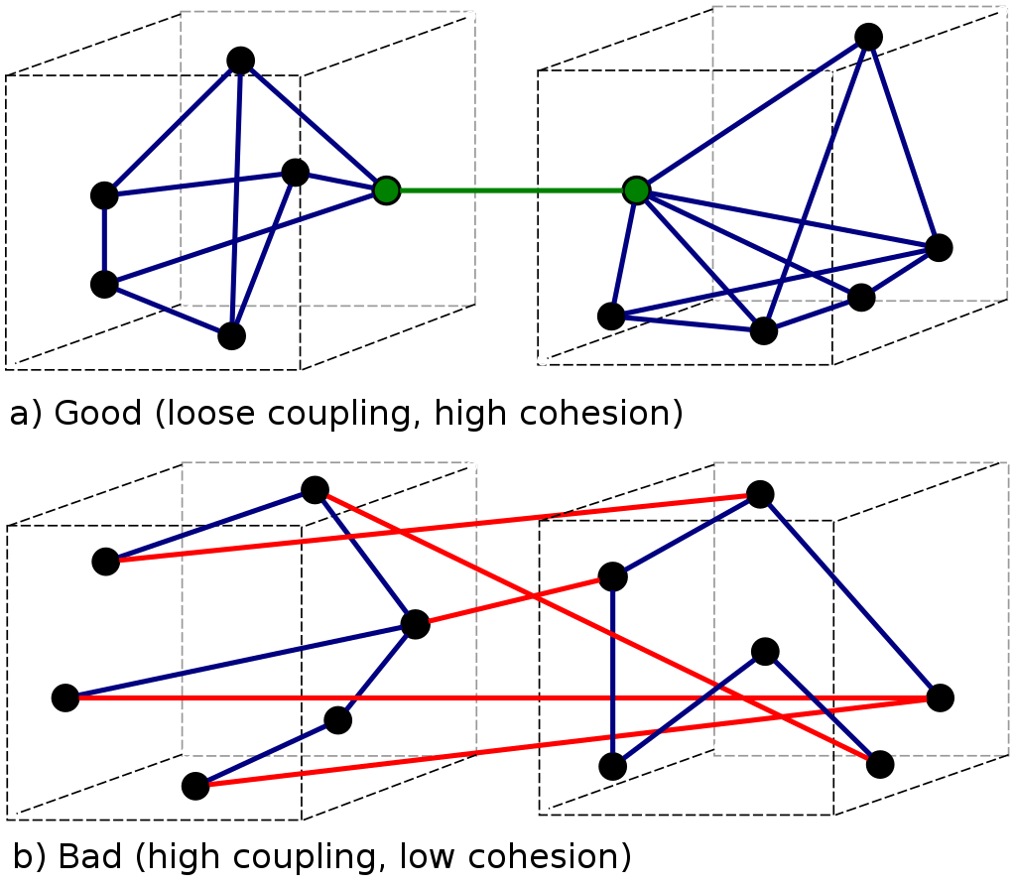
2.4 Modularity in software development: cohesion and coupling

Slide 12
2.5 Modularity in software development: cohesion
Defines the degree to which elements of a module belong together
General principle: more smaller > fewer larger
Methods
Classes
Data types and DTOs
Solutions (Microservices)

Slide 13
2.7 Cohesion for functions
‘The first rule of functions is that they should be small. The second rule of functions is that they should be smaller than that’ – Bob Martin

Slide 14
2.8 Cohesion for functions – code smells
Code smells:
Empty lines
Descriptive comments
Too many parameters
Flag parameters
‘Cookbook’ pattern
If-else/case-switch statements
Solutions:
Extract method
Replace comments with named methods
Larger methods with multiple parameters → more methods with fewer parameters
Group variables with the parts of a method using them – don’t frontload. Then extract.
Open-closed principle

Slide 15
2.6 Cohesion for classes
Two principles:
Non-primitive types can be defined by their inputs and outputs
A class’ fields are its methods’ stable oblique inputs
Applications
Every method in a class uses every field
One model per controller or repository class
Every property on a DTO should be populated on every use – avoid nullable properties
Database normalization

Slide 16
3 Demos

Slide 17
4 Questions

